Slide 1
The impact of marine heatwaves depends on ploidy in the Pacific oyster
NWFSC Climate Meeting
7/12/2022
Matthew George, Ph.D.
mngeorge@uw.edu

Slide 2
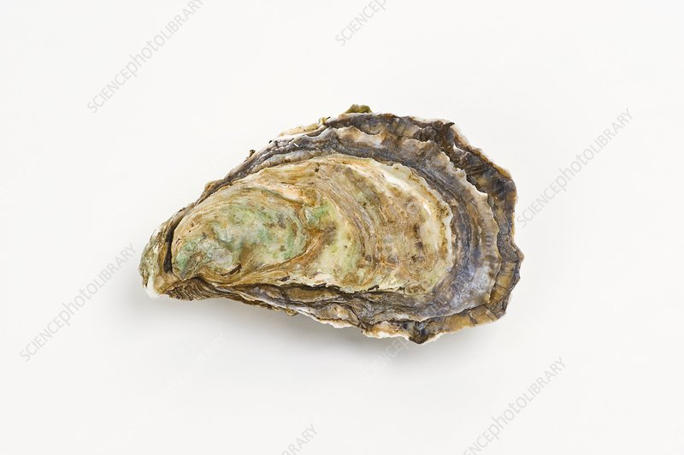

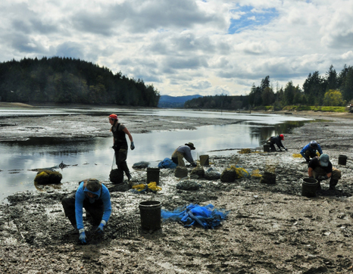
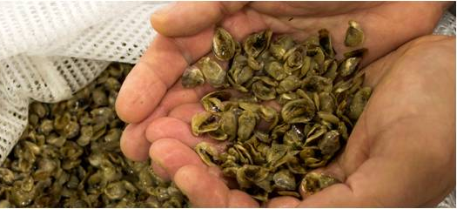
Pacific Oysters – tolerance is survival
Introduction
Pacific Oyster

Slide 3
Reproductive control in Pacific oysters
Introduction
Various methods used to induce triploidy (tetraploid cross, heat-shock, pressure, etc.) starting in the late 1970’s.
Triploid oysters have an extra chromosome set (3n).
Triploidy significantly reduces energetic investment in gonad production.
Triploid oysters have superior growth rates.
Harvesting triploids in the summer avoids the unpleasant taste of ‘spawny’ oysters.

Slide 4
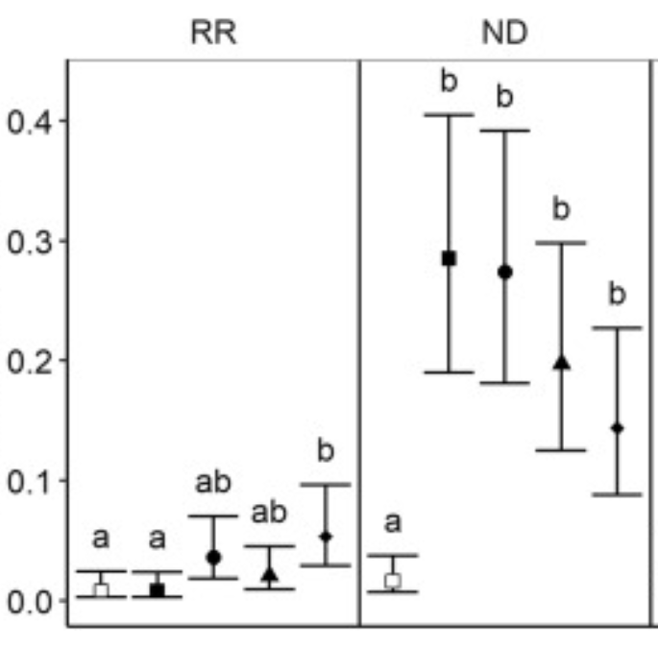
Diploid vs. Triploid mortality in the field
Introduction
Gulf of Mexico
Chesapeake Bay
Triploid
Cumulative mortality (%)
Probability of mortality
Field mortality extending through the summer
Diploid
Wadsworth 2018; http://hdl.handle.net/10415/6074
Matt et al. 2020; doi: 10.1016/j.aquaculture.2020.735375

Slide 5
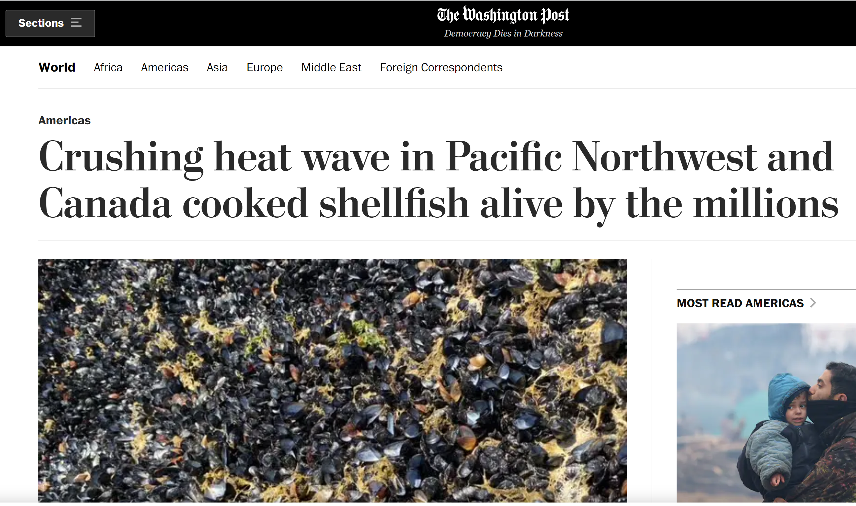
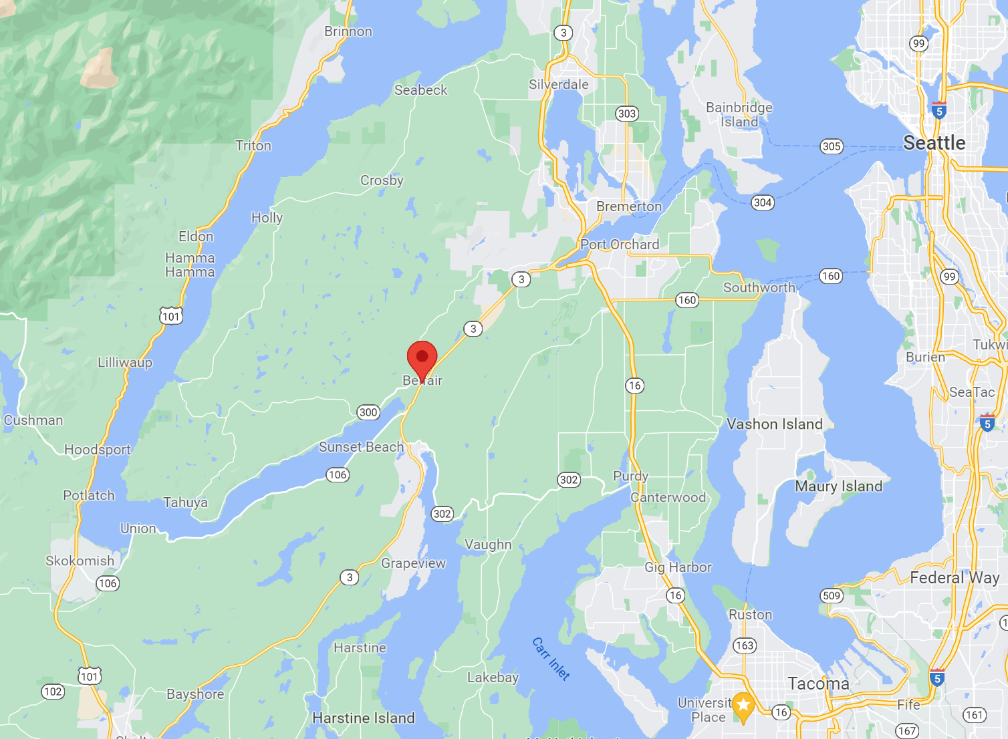
Marine Heatwaves
Introduction
June 2021
Air temp
40-45°
water temp
20-35°

Slide 6



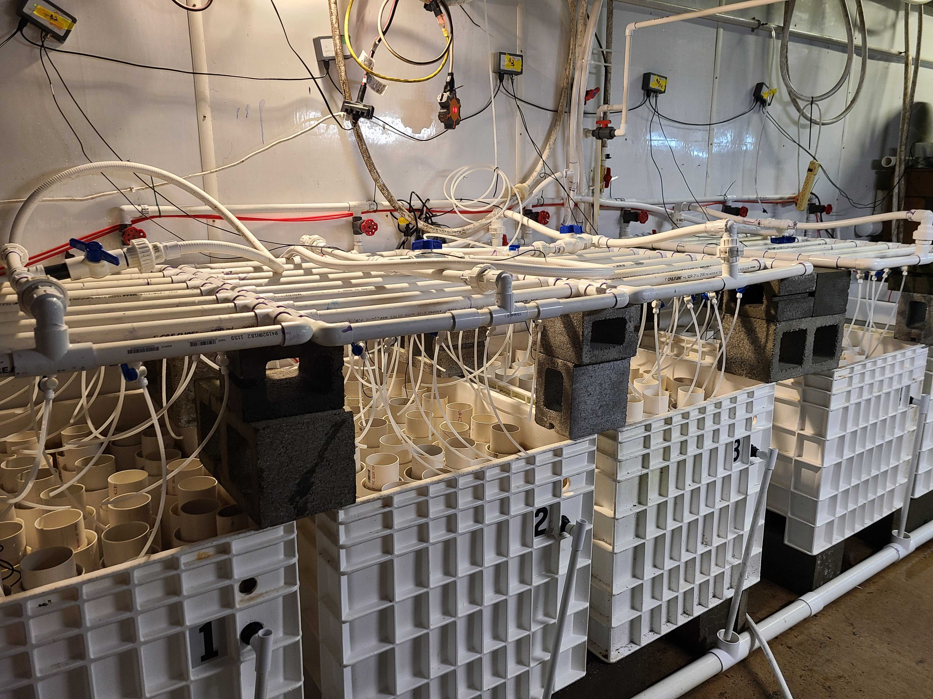
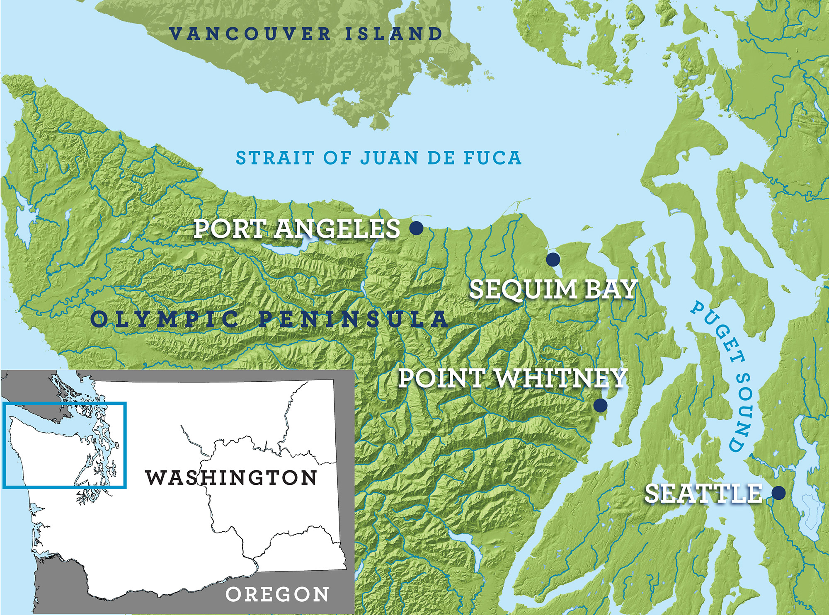
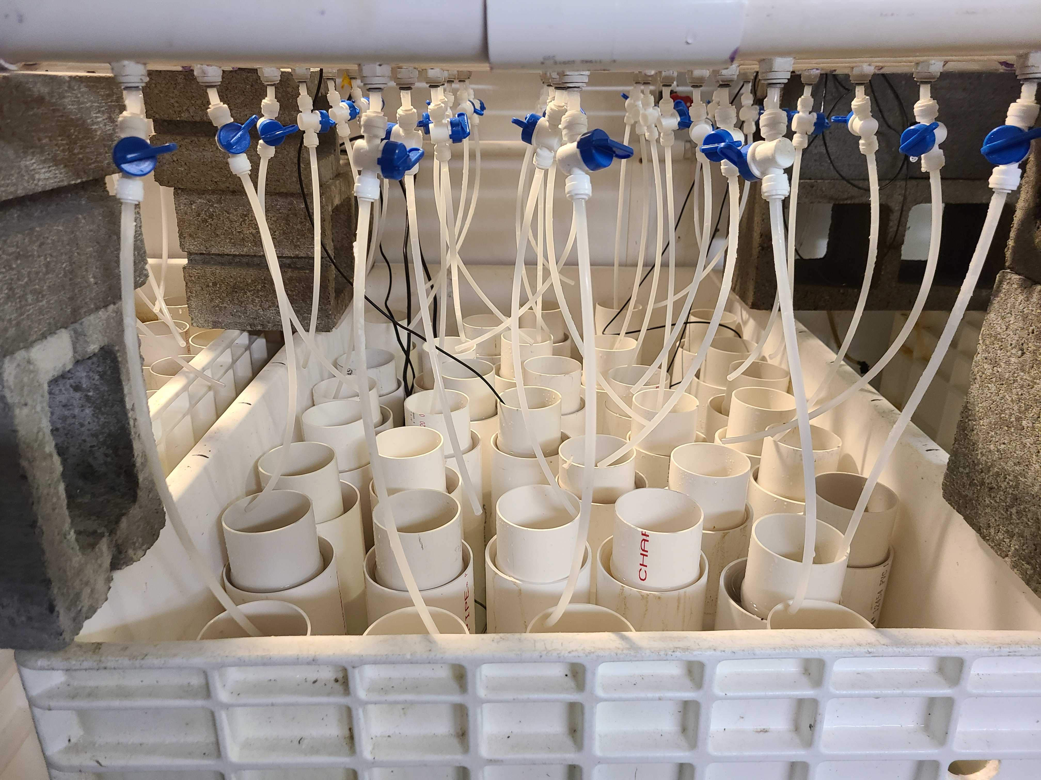
Point Whitney Shellfish Hatchery
Partners:

Slide 7
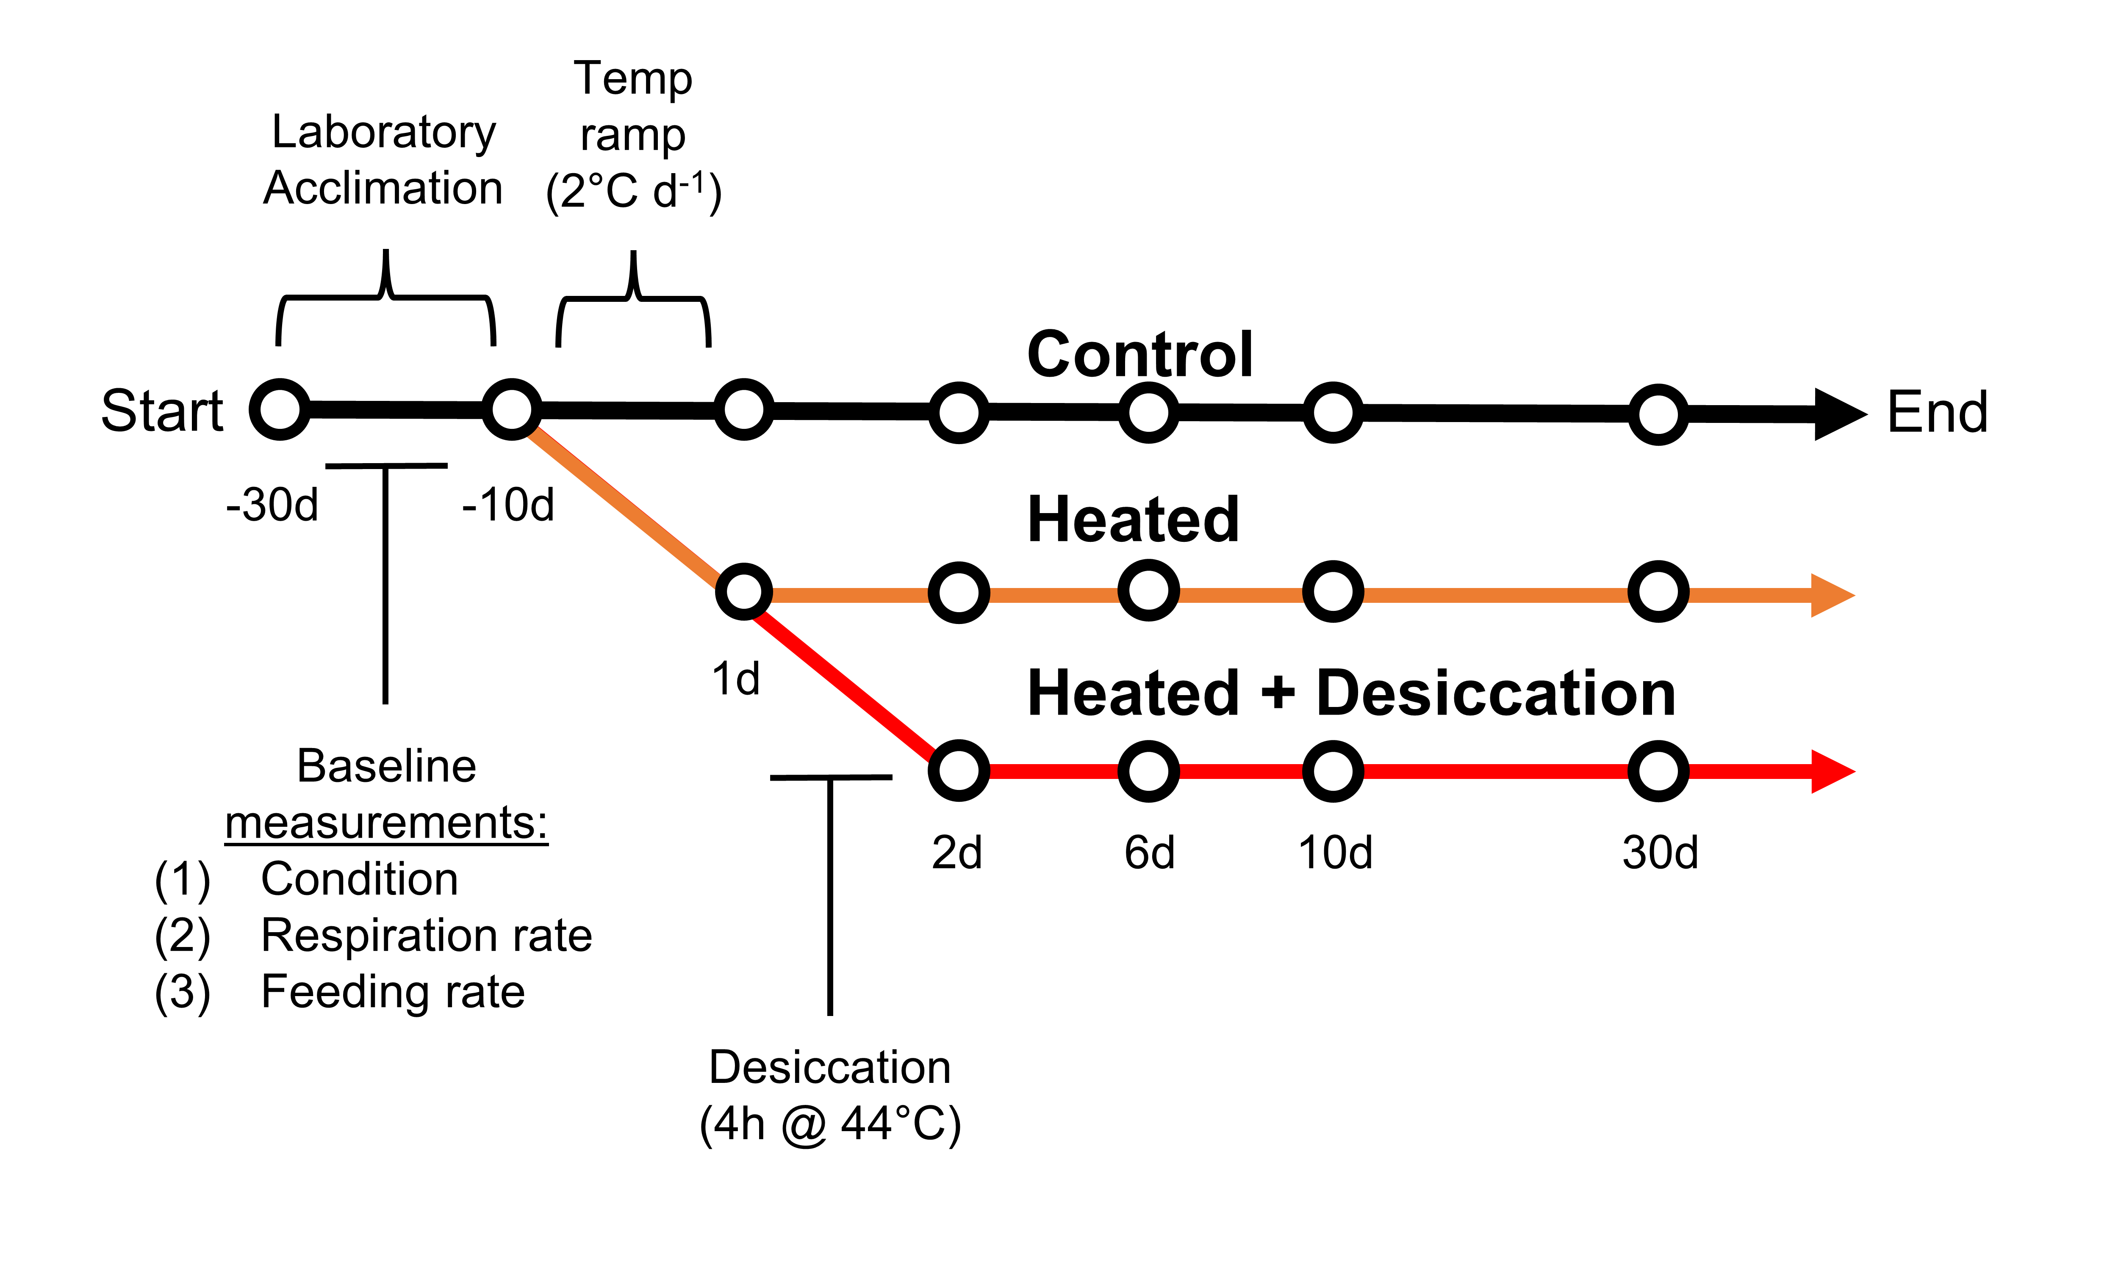
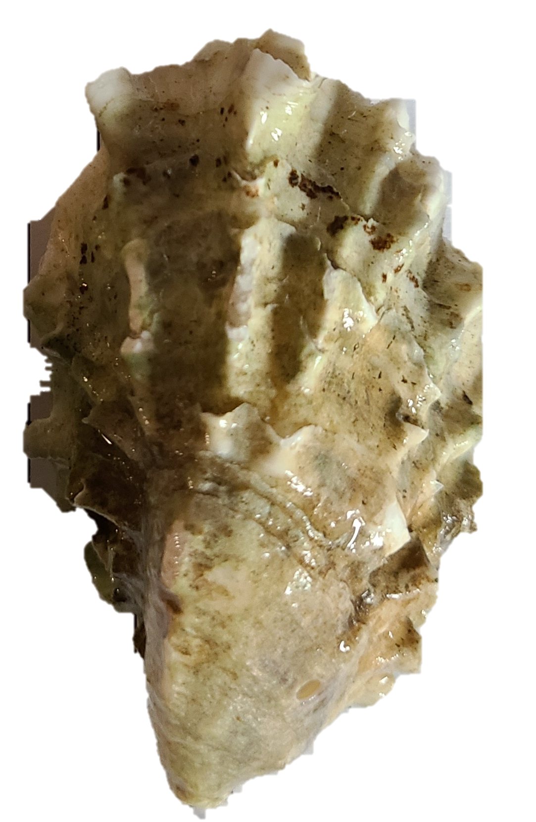
Experimental Design
Methods
(30°C)

Slide 8
Experimental Design
Methods
(30°C)

Slide 9
Experimental Design
Methods
(30°C)

Slide 10
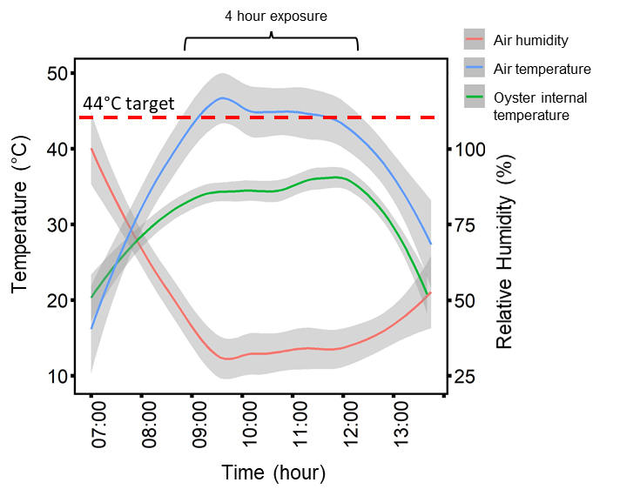
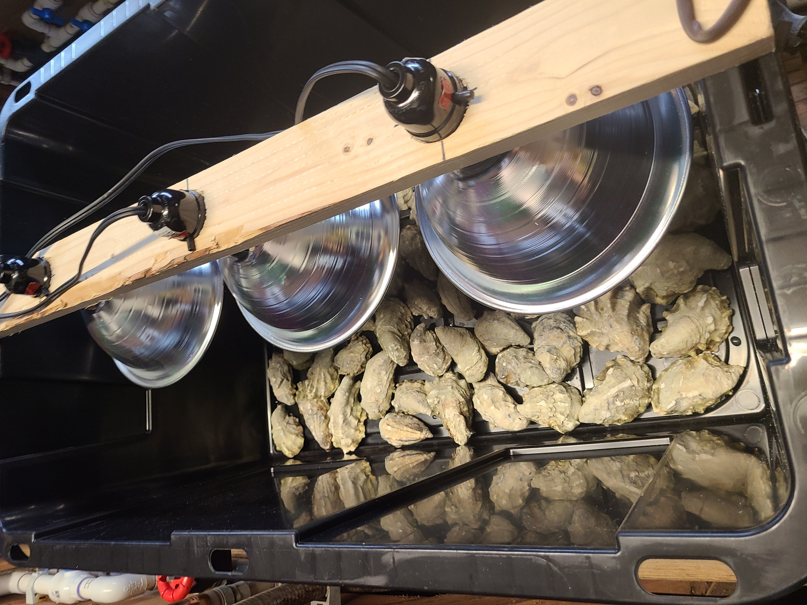
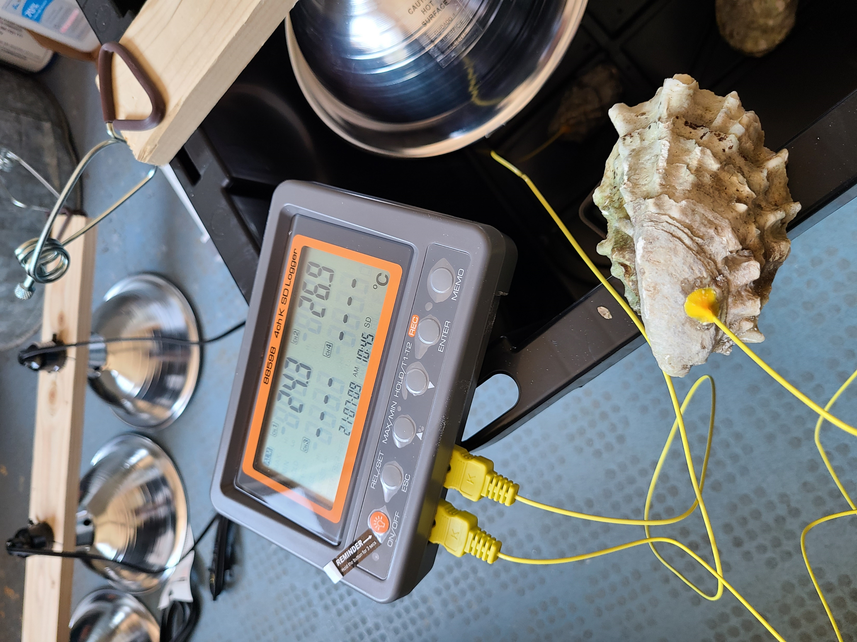
Desiccation
Methods

Slide 11
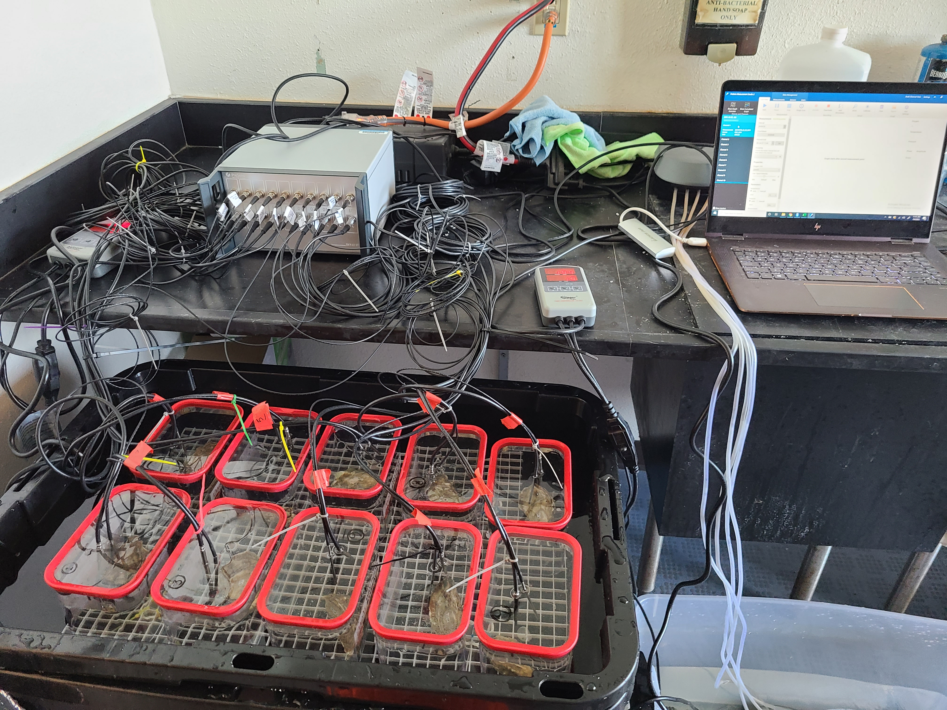
Measurements
Methods
Mortality
Metabolic Rate
Na⁺/K⁺-ATPase enzyme activity
RNA sequencing (Tag-seq) – Gene expression

Slide 12
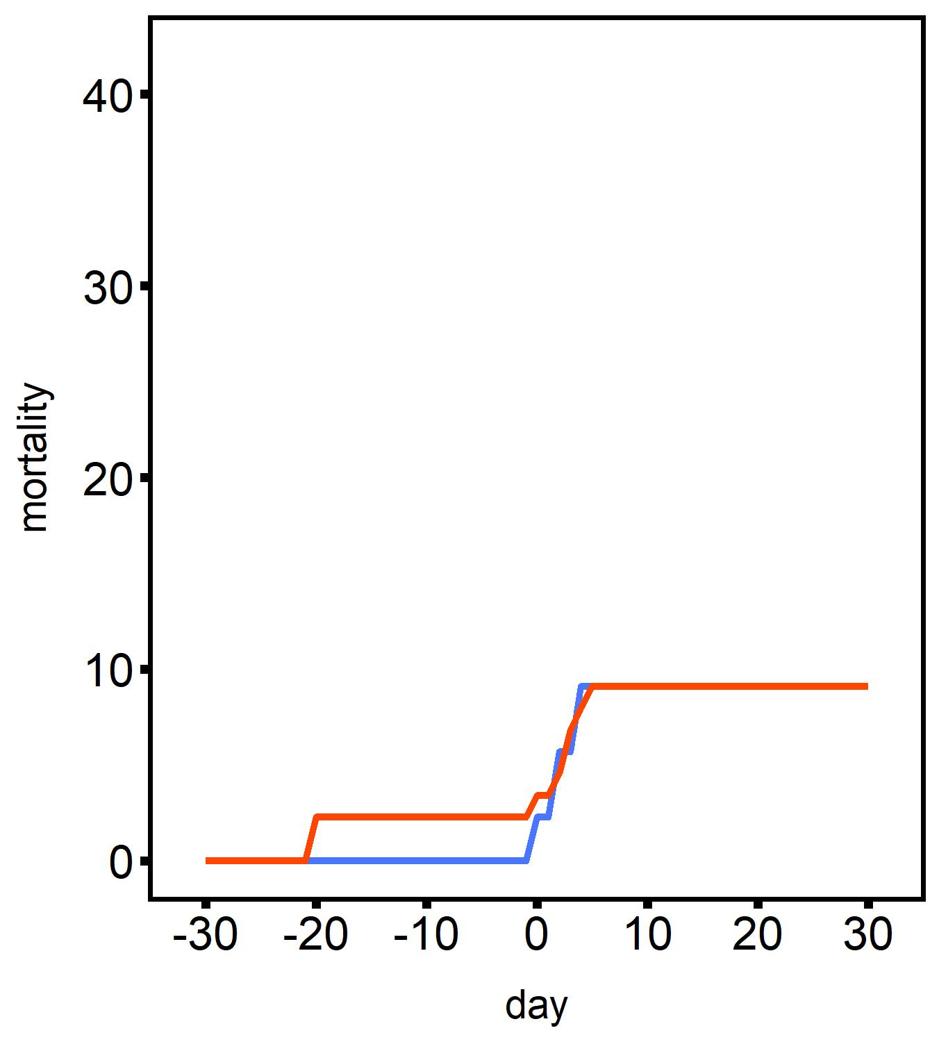
Mortality
Results
20°C
2°C d⁻¹ ramp
30°C
Treatment
2n - heated
3n - heated
2n - heated
3n - heated
3n - heated +
desiccation

Slide 13
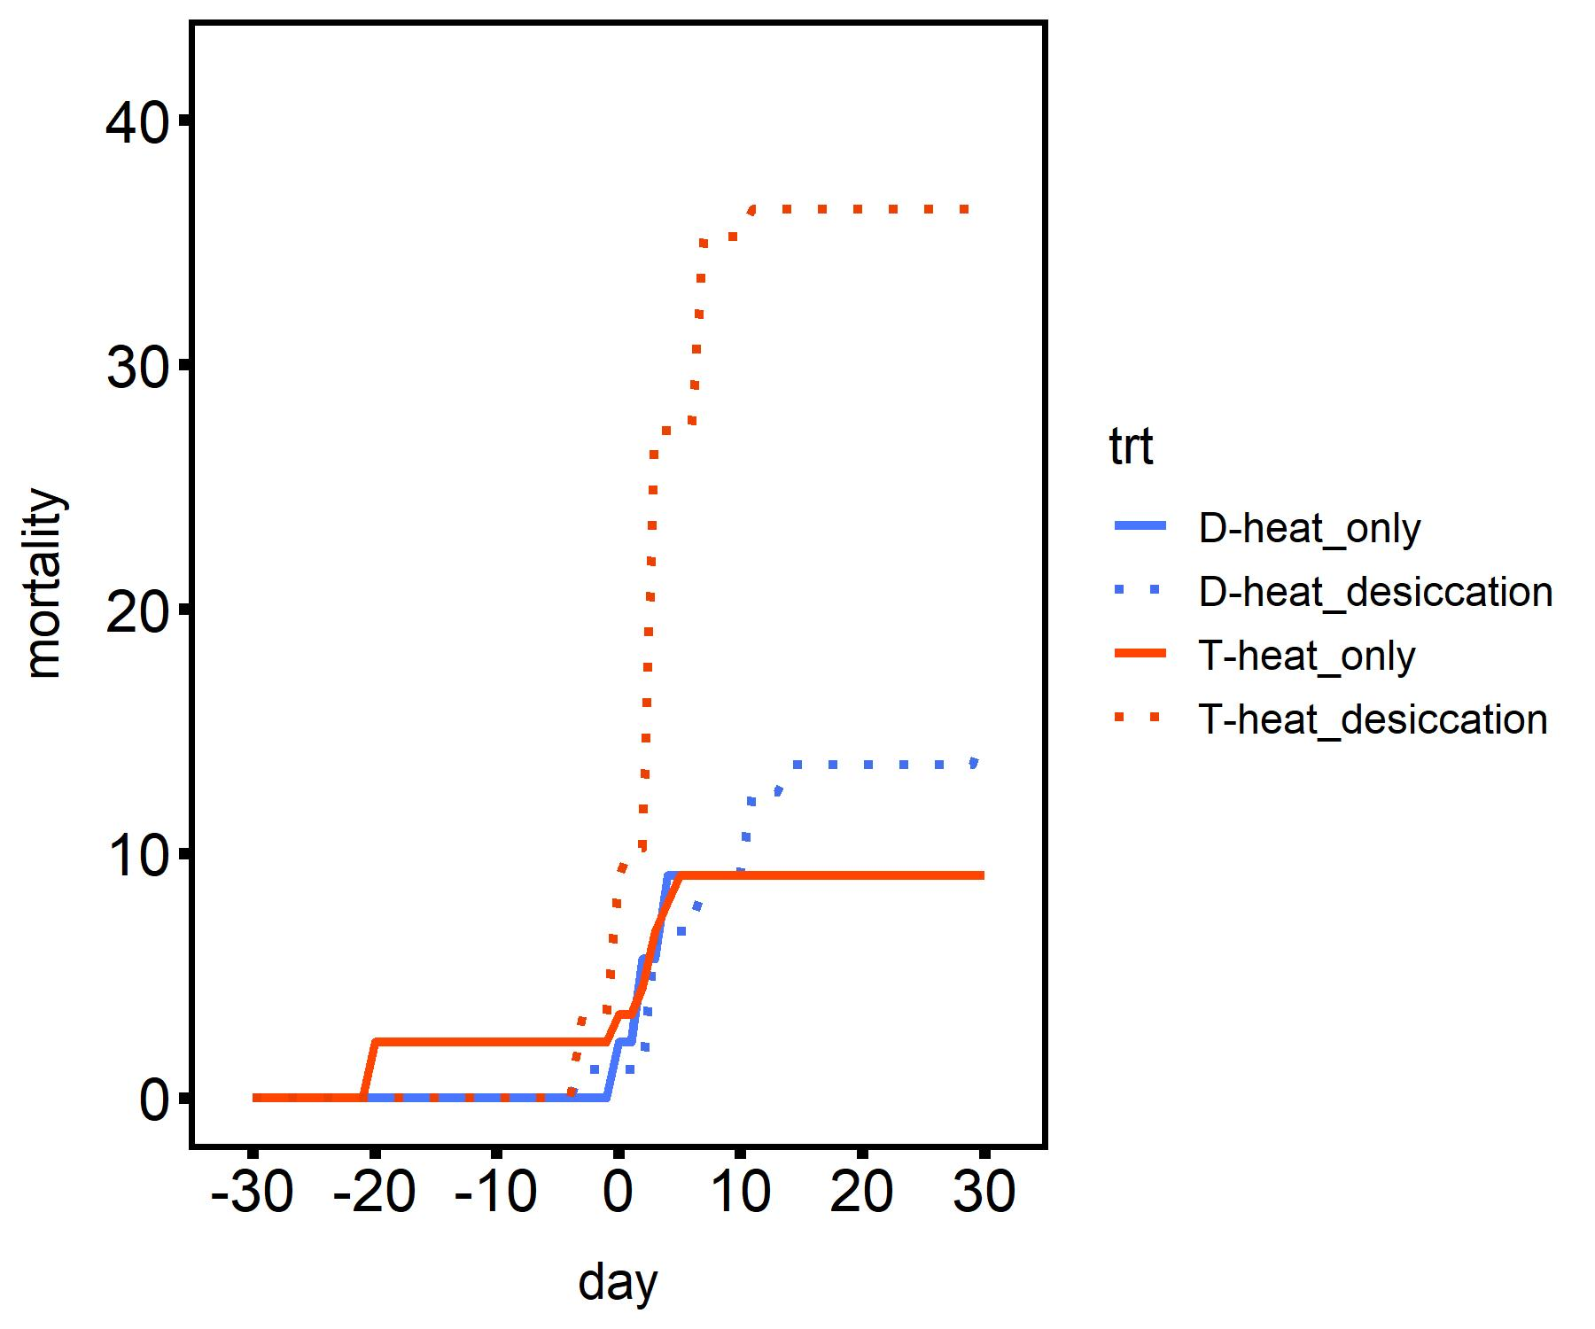
Mortality
Results
Desiccation
4 h @ 44°C
20°C
2°C d⁻¹ ramp
30°C
Treatment
2n - heated
2n - heated +
desiccation
3n - heated
3n - heated +
desiccation

Slide 14
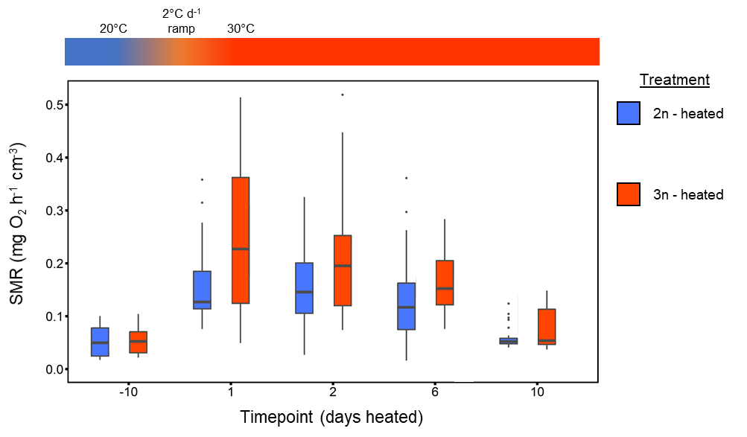
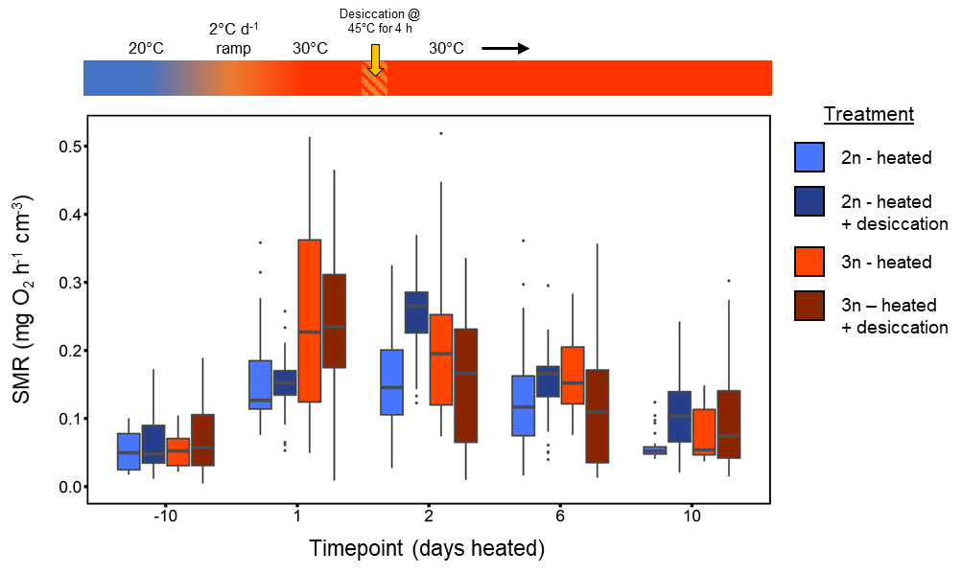
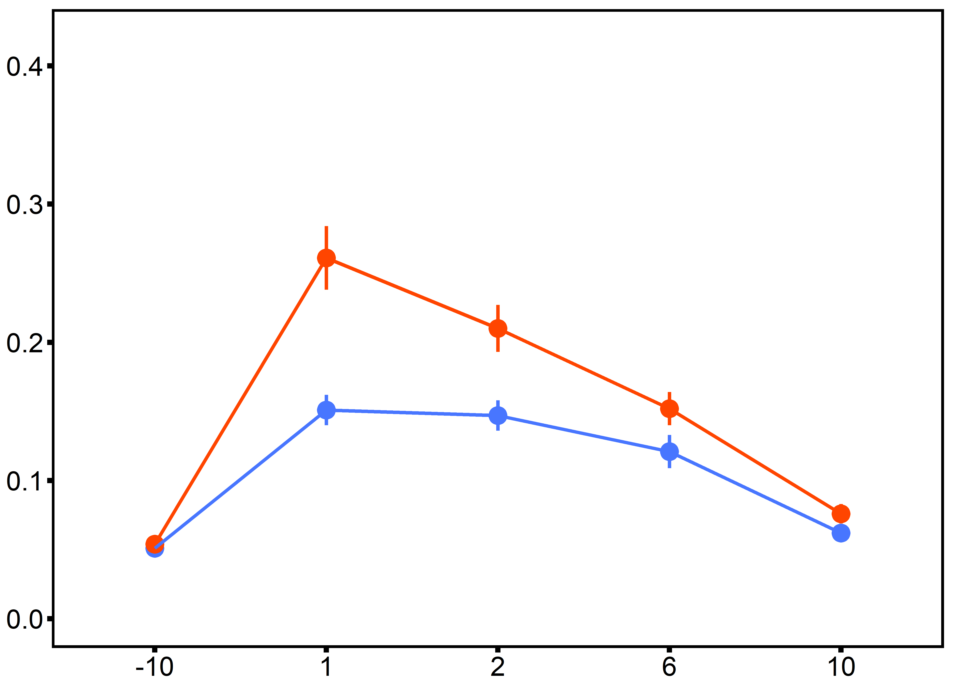
Metabolic Rate
Results
Treatment
2n - heated
3n - heated
2n - heated

Slide 15
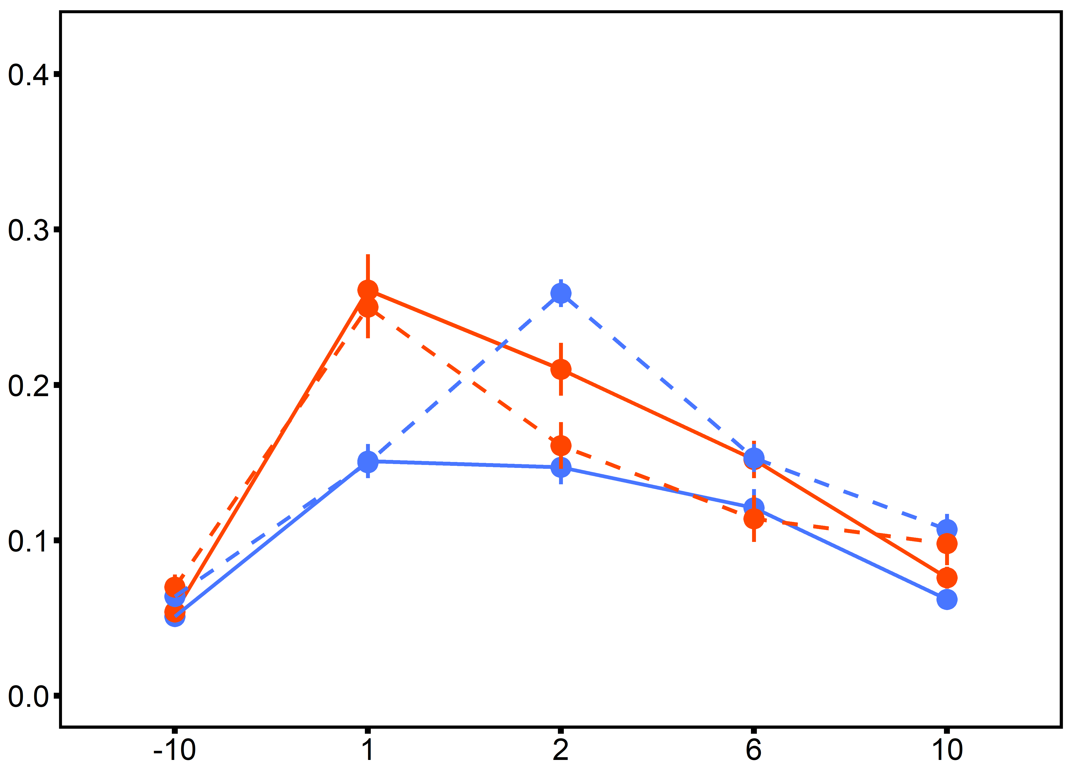
Metabolic Rate
Results
Desiccation
4 h @ 44°C
Treatment
ploidy: p=0.003
time: p<0.001
ploidy×time: p=0.03
2n - heated
2n - heated +
desiccation
3n - heated
3n - heated +
desiccation

Slide 16
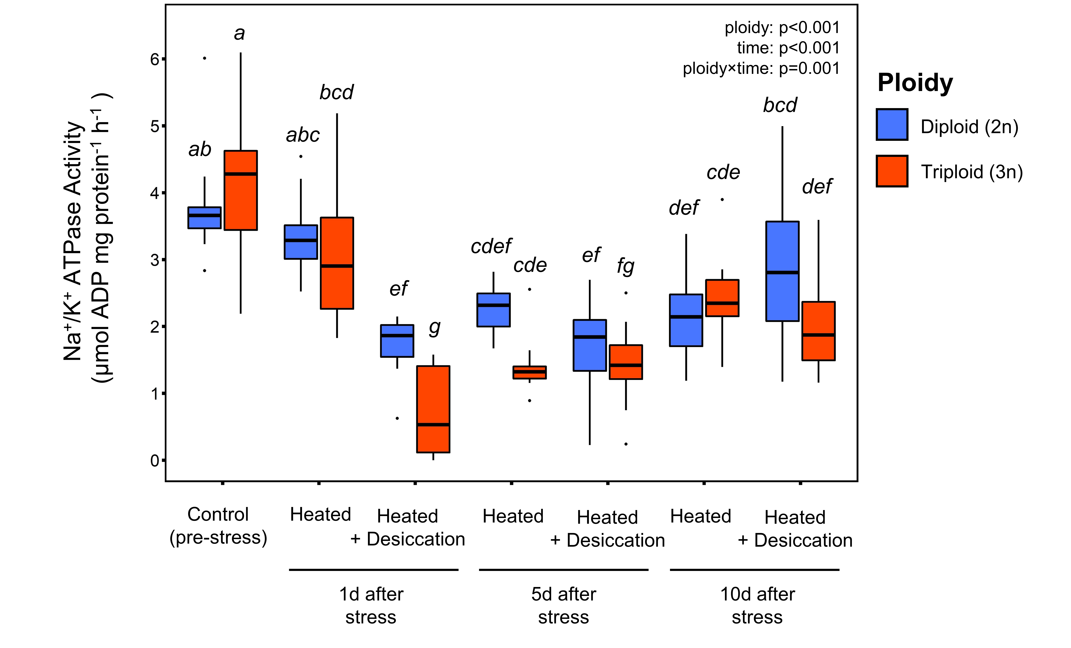
Na⁺/K⁺-ATPase Activity
Results

Slide 17
Na⁺/K⁺-ATPase Activity
Results

Slide 18
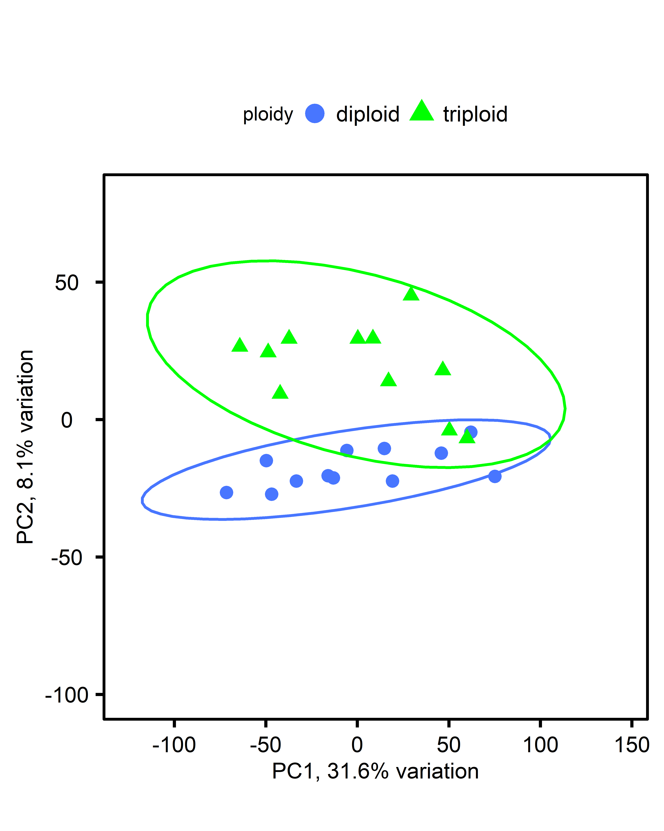
How are triploids different?
Results
79 DEGs
Top 10 upregulated genes when comparing control diploid and triploids
Log2 fold change | Gene Symbol | Description | Category
+5.1 | LOC105325880 | complement C1q-like protein 3 | Immune
+4.3 | LOC117686832 | perlucin-like protein isoform X2 | Biomineralization
+3.0 | LOC117691676 | C-type lectin mannose-binding isoform-like isoform X1 | Metabolism
+2.5 | LOC105347275 | double homeobox protein B | Transcription
+2.3 | LOC117683057 | fibroleukin-like | Immune
+2.3 | LOC105337372 | C1q-related factor | Immune
+2.2 | LOC105320431 | histone H2A | Epigenetics
+2.1 | LOC105343956 | complement C1q-like protein 3 | Metabolism
+2.0 | LOC105320412 | histone H2A | Epigenetics
+1.9 | LOC105320418 | histone H2A | Epigenetics
Control only

Slide 19
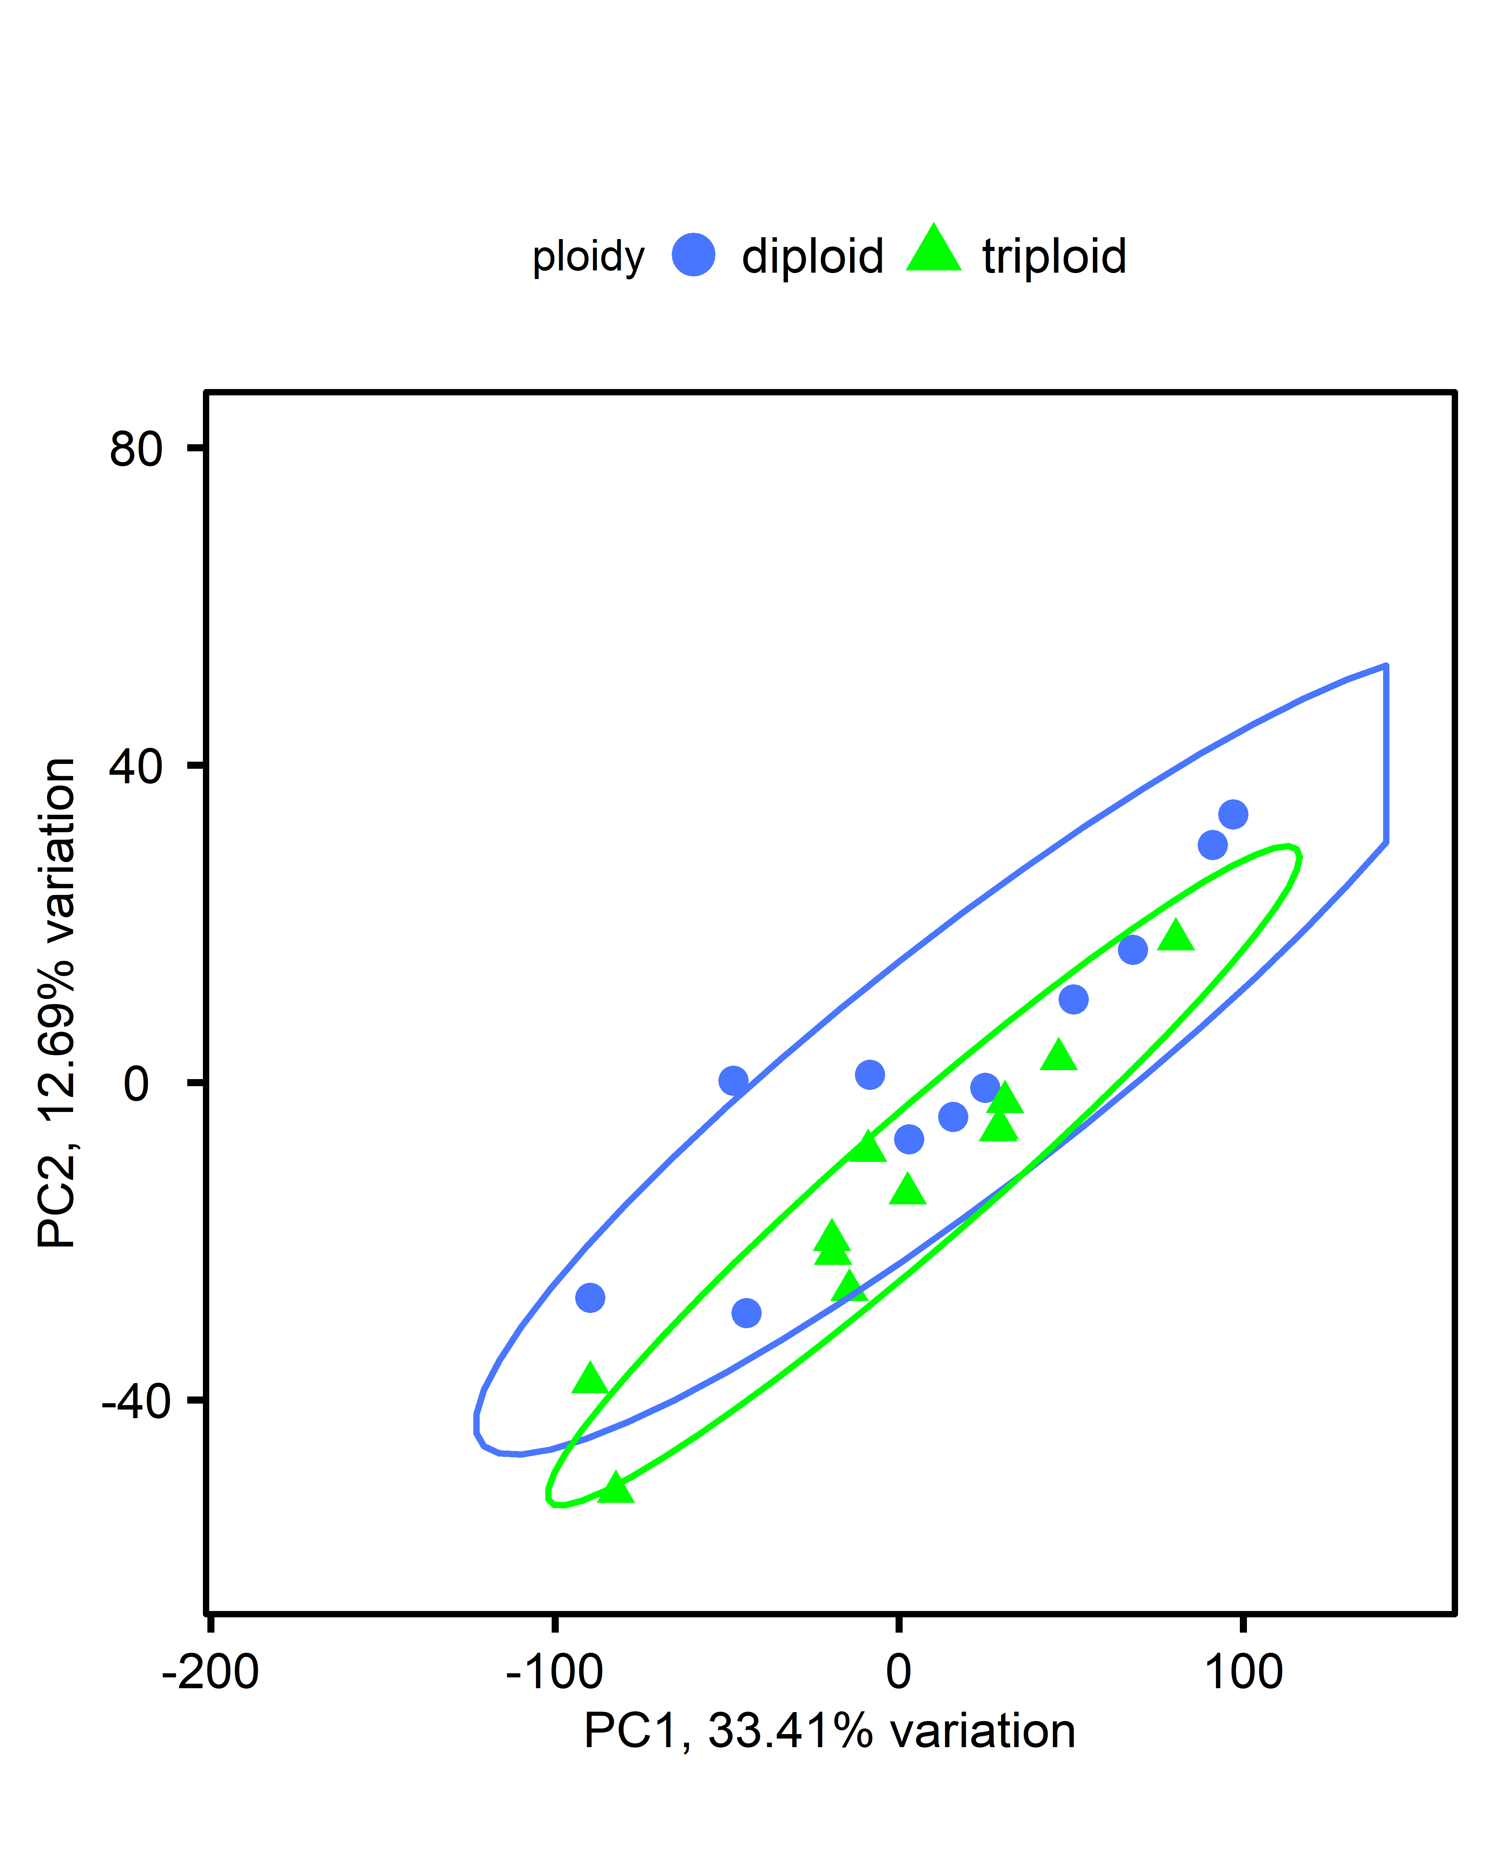
Does gene expression match physiology ?
Results
Results of KEGG pathway analysis comparing diploid and triploids after multi-stress exposure
90 identified DEGs
Log2 fold change | Gene Symbol | KEGG Pathway Identifier | Description
-3.4 | LOC105336299 | crg00230 | Purine, Pyrimidine, & Glutathione metabolism
-2.52 | LOC105318146 | crg04142 | Lysosome
-2.28 | LOC105346726 | crg04145 | Phagosome; ECM-receptor interaction
-1.62; -1.53 | LOC105342404; LOC105348387 | crg00350 | Tyrosine metabolism
1.69 | LOC117688097 | crg04137 | Mitophagy
2.23 | LOC109618002 | crg04080 | Neuroactive ligand-receptor interaction

Slide 20
Conclusions
Conclusions
Heat stress alone did not result in mortality.
Multiple stressors resulted in ‘triploid mortality’.
Triploids exhibited metabolic depression and a reduction in ATPase enzyme activity after multiple stress exposure.
Upregulated DEGs in triploids are associated with GOterms involved in metabolism, immunity, and epigenetic regulation.
KEGG pathway analysis support physiological observations of the breakdown of cellular metabolism and mitochondrial function in triploids following exposure to multiple stressors.

Slide 21

Partners & Funding Sources

